Slide 1


Gen AI Application Developer’s Course
Dr. Rakhee Chhibber

Slide 2
TOC for the
Gen AI Course TOC.docx

Slide 3
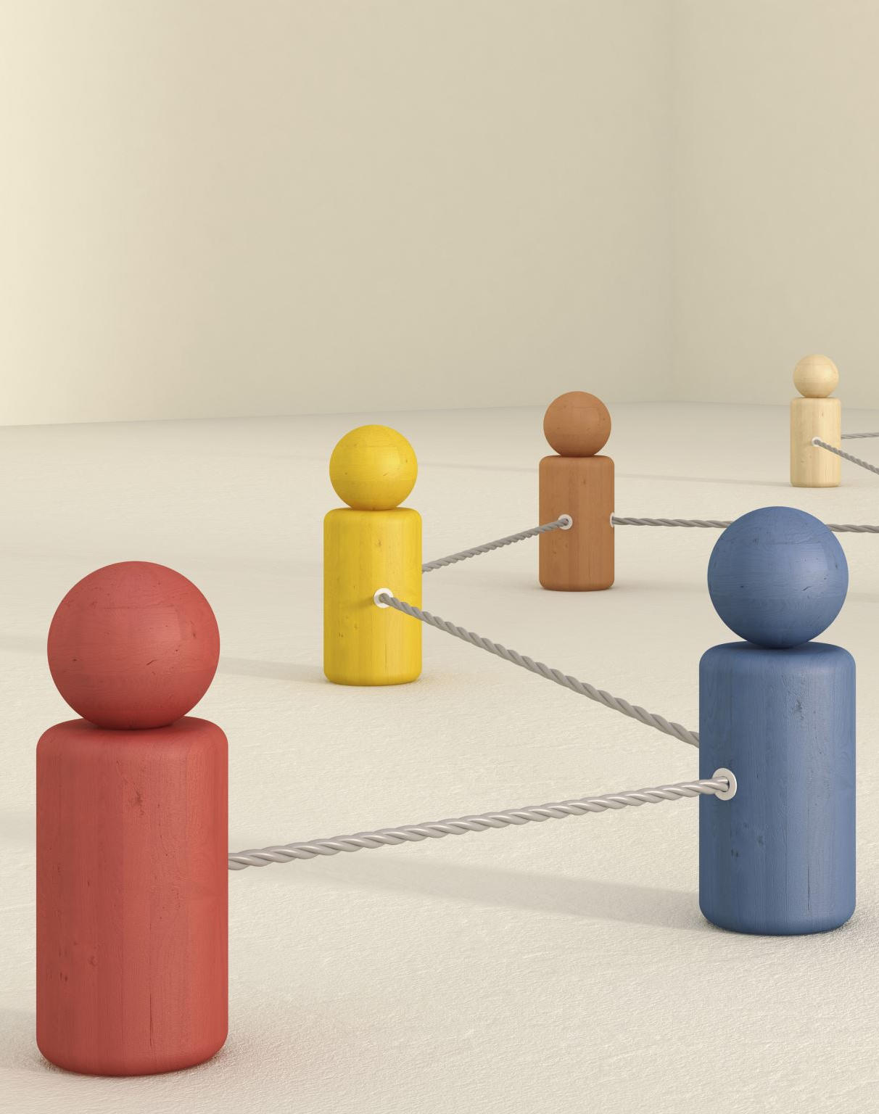
AGENDA
Introduction to AI and ML
Broad AI and Narrow AI
AI community leaders
Types of learning
Supervised
Un-supervised and
Semi-supervised & Reinforcement
Types of models
Types of algorithms in each model

Slide 4
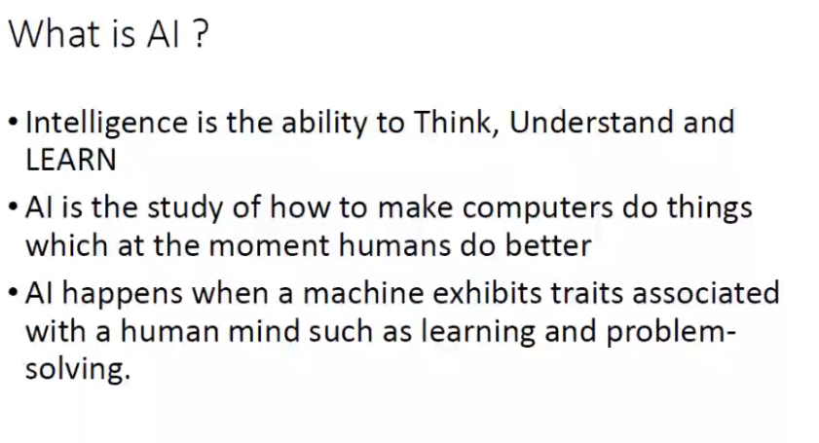

Slide 5
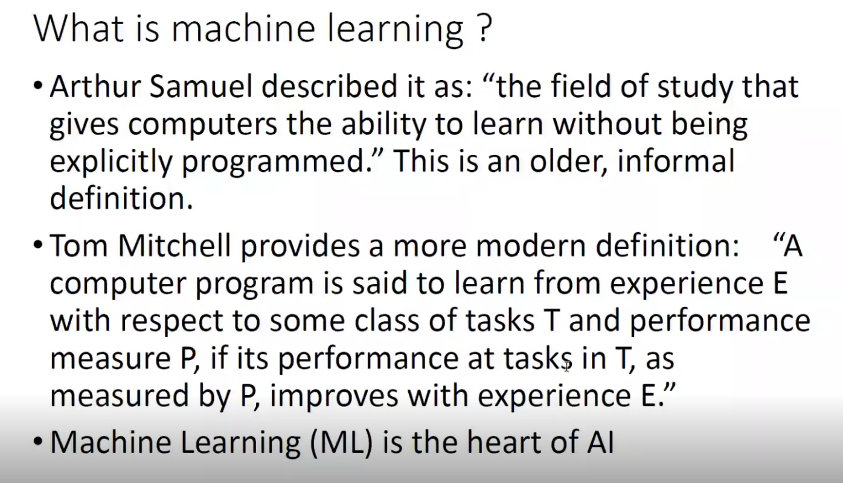

Slide 6
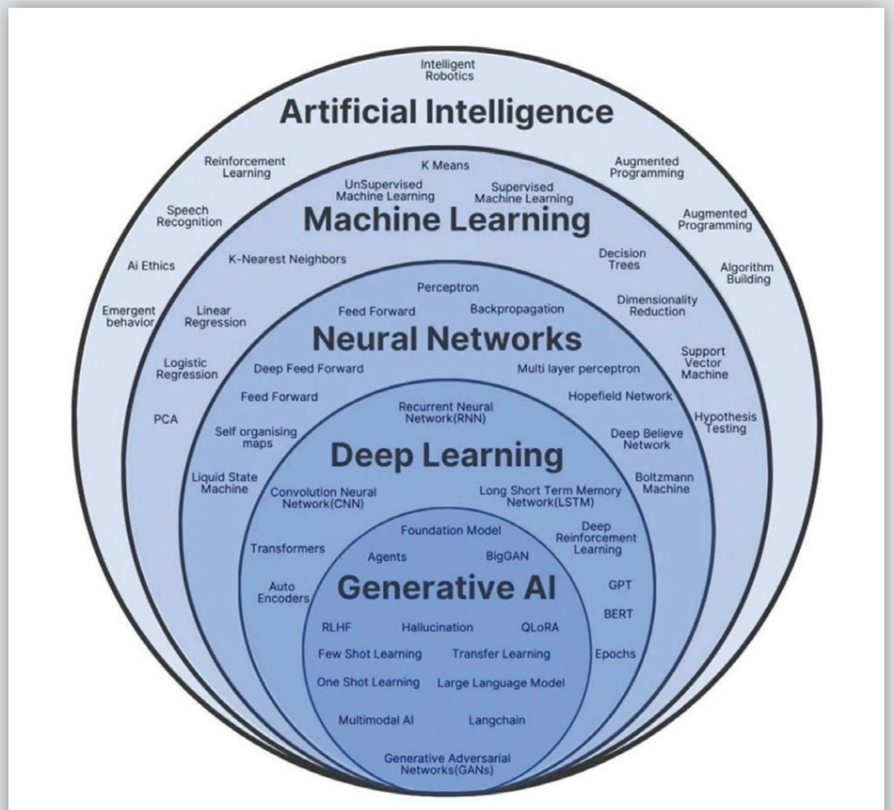

Slide 7
Types of AI: Narrow Versus General AI
Narrow AI (or Weak AI) - systems that are designed to handle specific tasks. These systems excel at performing one task at a time, such as playing chess, facial recognition, or language translation. They can’t adapt to tasks outside their designated function. like Google Search, Spotify recommendations, and smart home devices.
General AI (or Strong AI)- systems with the ability to perform any cognitive task that a human can do. General AI is more ambitious, aiming to create machines with human-like understanding and problem-solving abilities across various domains.it is a theoretical and not yet been realized.

Slide 8
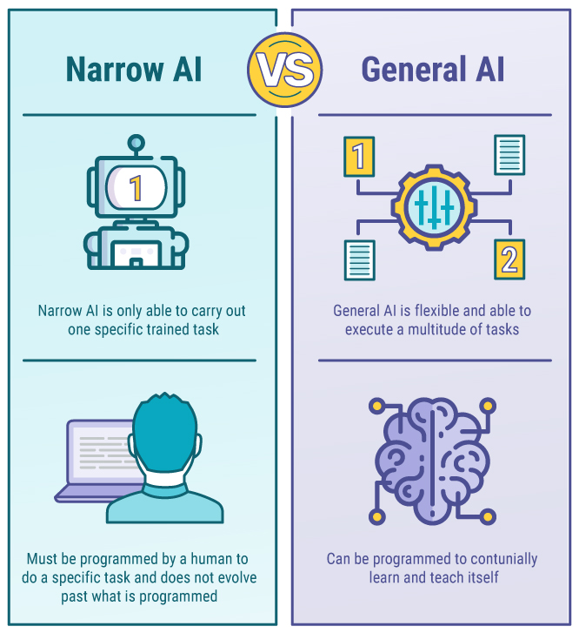

Slide 9
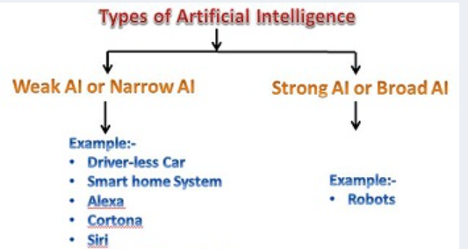

Slide 10
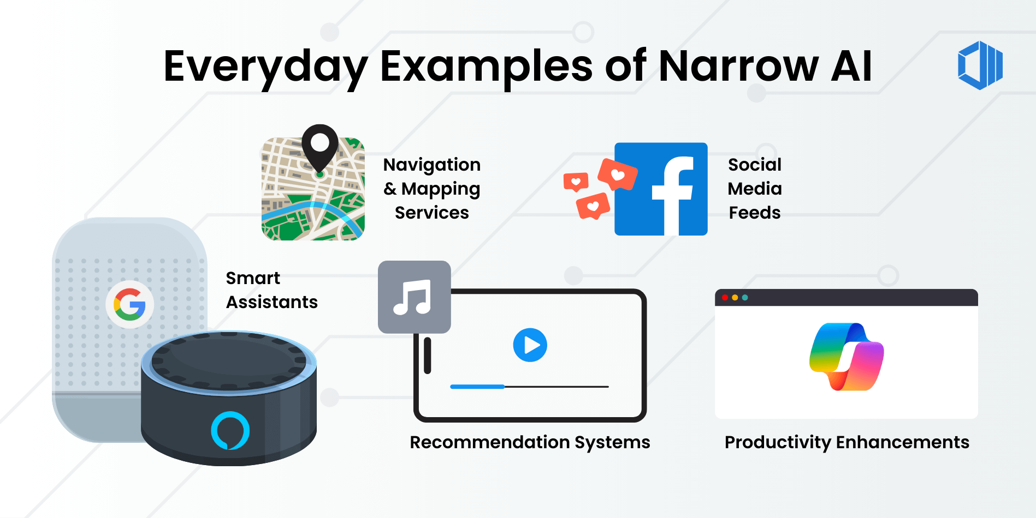

Slide 11
AI Leaders – Summary
Company | Revenue | Employees | CEO | Founded
AI Transformation (ServiceNow) | US$10.98bn | 26,293 | Bill McDermott | 2004
LandingAI | US$19.3m | 112 | Dan Maloney | 2017
xAI | US$500m | 1,200 | Elon Musk | 2023
Perplexity | US$148m | 1,222 | Aravind Srinivas | 2022
Meta (Meta AI) | US$47.5bn | 75,945 | Mark Zuckerberg | 2004
Microsoft AI | US$76.4bn | 228,000 | Mustafa Suleyman | 2016
Anthropic | US$4bn | 1,097 | Dario Amodei | 2021
Google DeepMind | N/A | 2,125 | Demis Hassabis | 2010
Nvidia | US$130.5bn | 36,000 | Jensen Huang | 1993
OpenAI | US$12bn | 2,659 | Sam Altman | 2015

Slide 12
Progression
AI ➜ Machine Learning ➜ Deep Learning ➜ Generative AI (Language Models) ➜ Retrieval-Augmented Generation

Slide 13
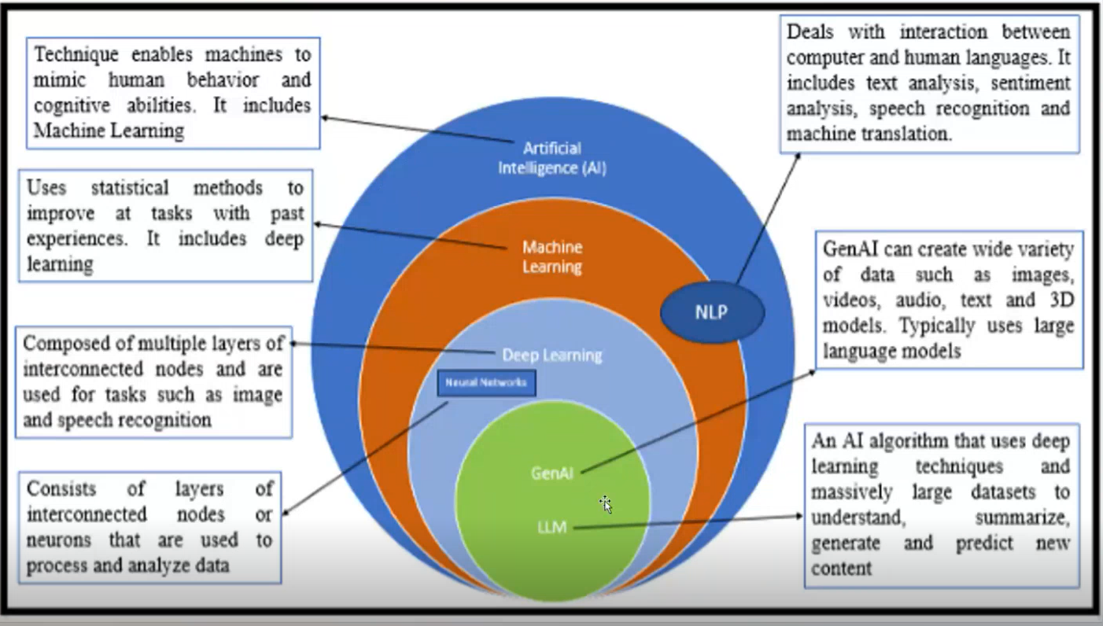

Slide 14
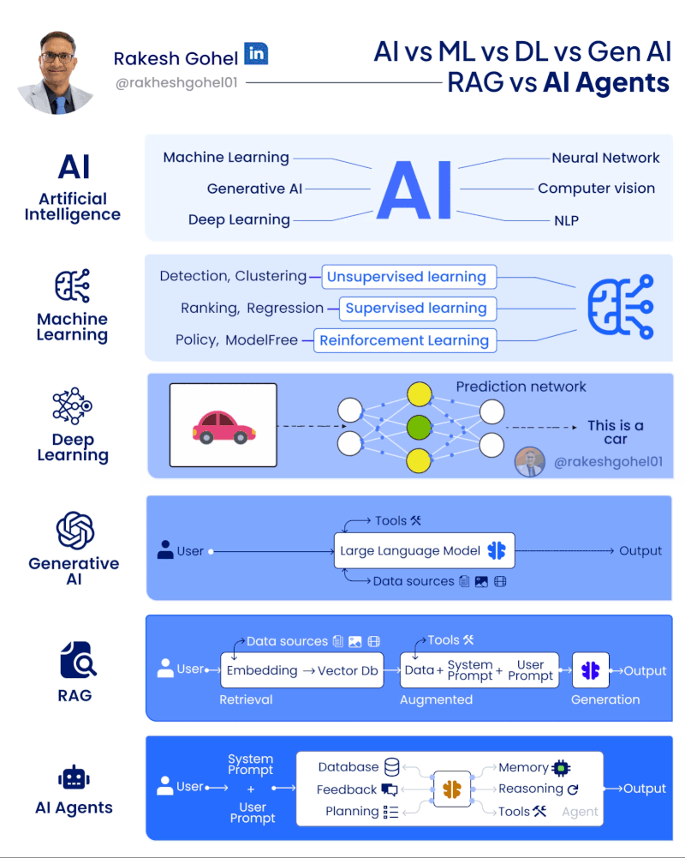
Progression towards building AI-agents

Slide 15
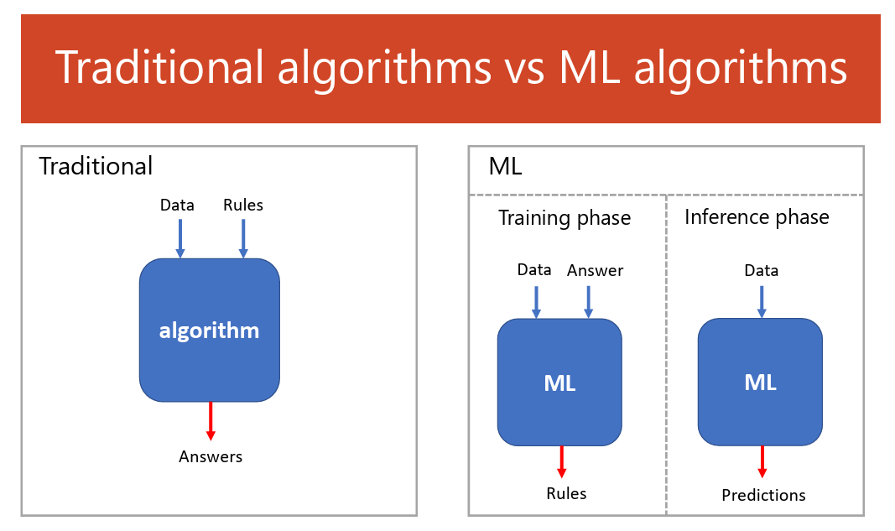

Slide 16
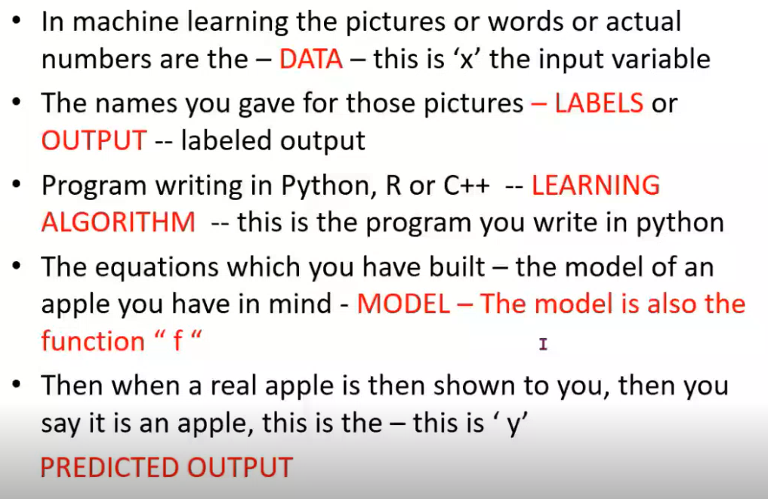
Introduction to ML

Slide 17
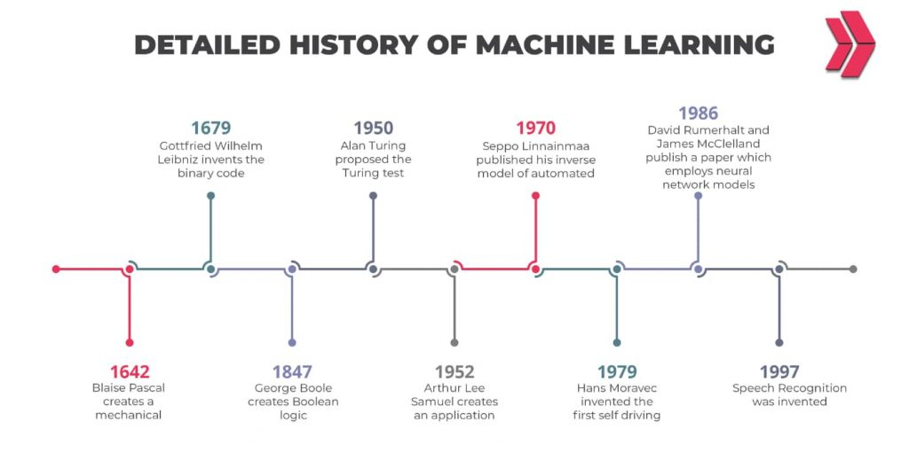

Slide 18
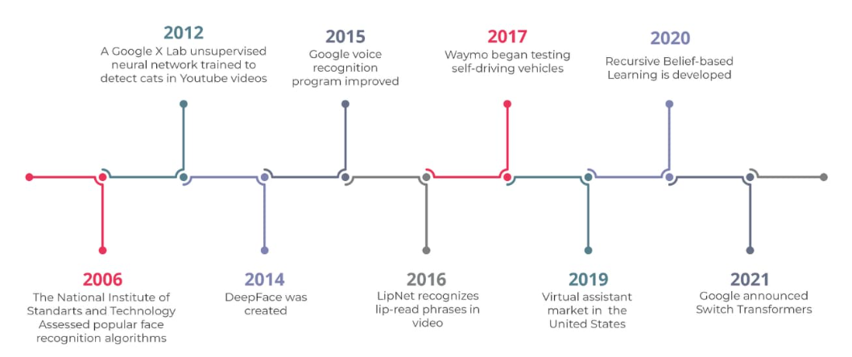

Slide 19
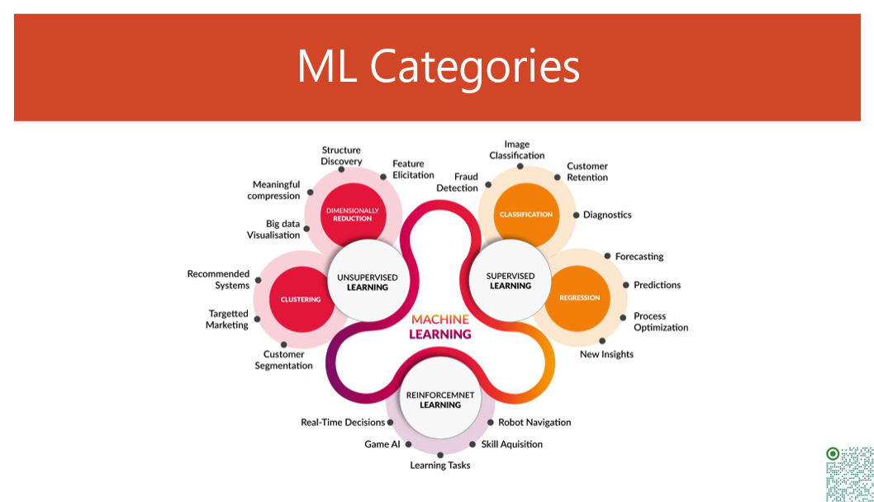

Slide 20
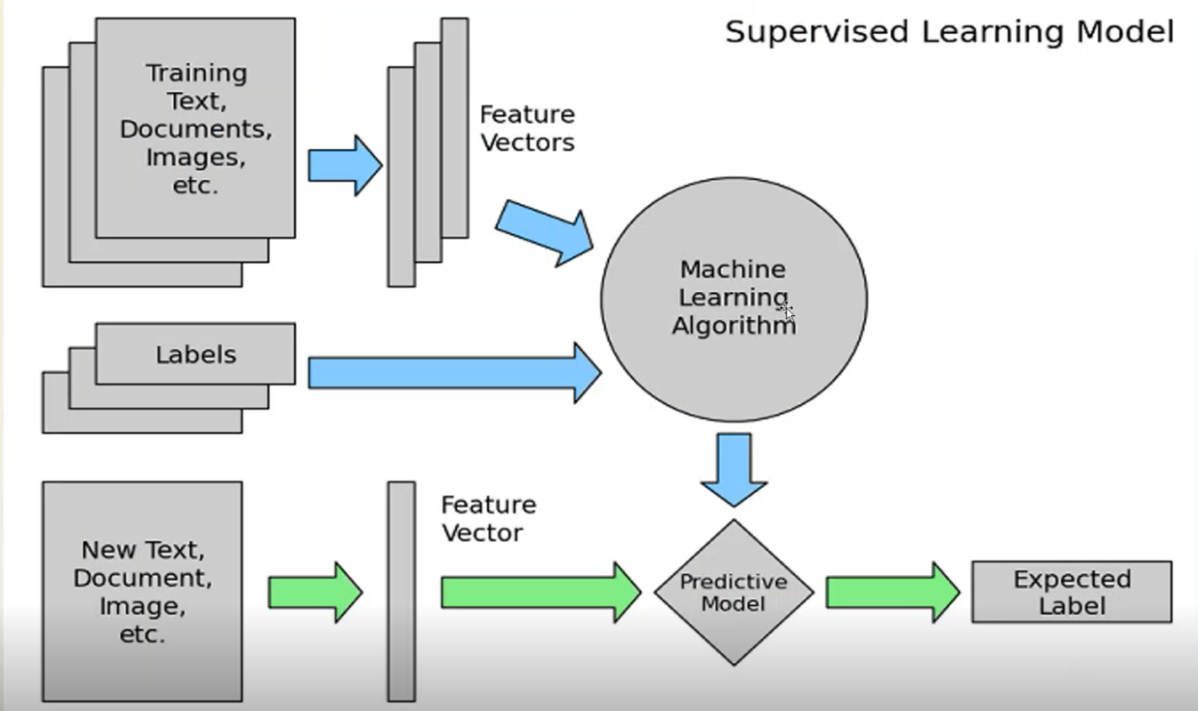

Slide 21
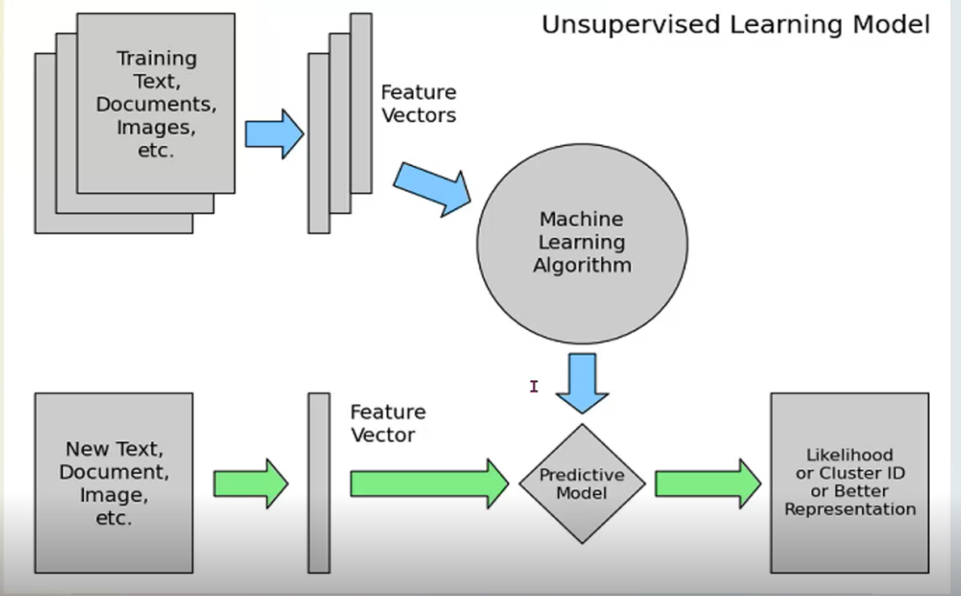

Slide 22
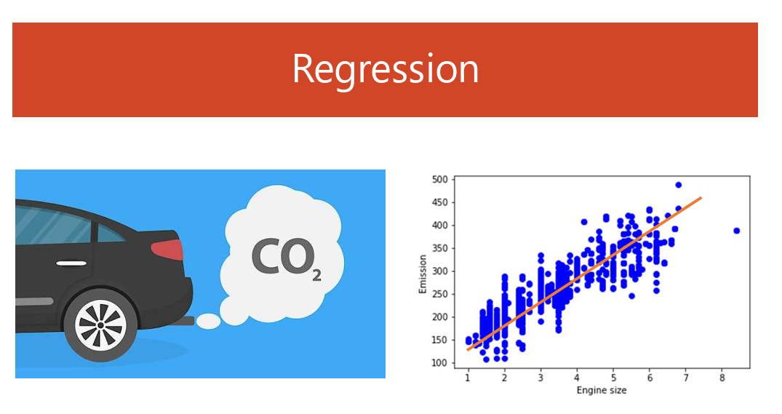

Slide 23
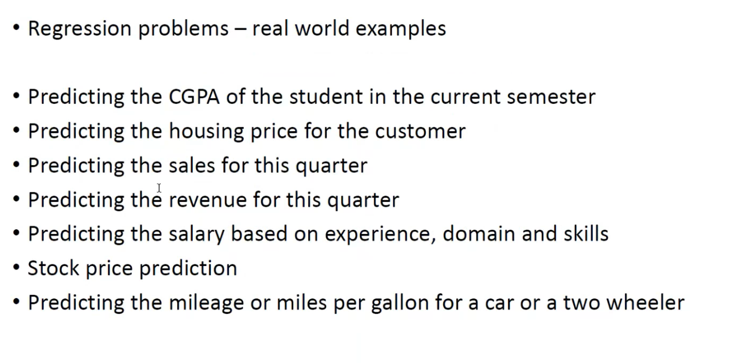

Slide 24
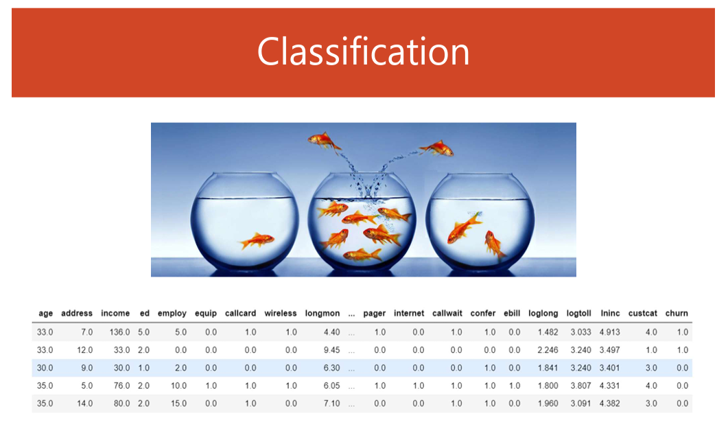

Slide 25
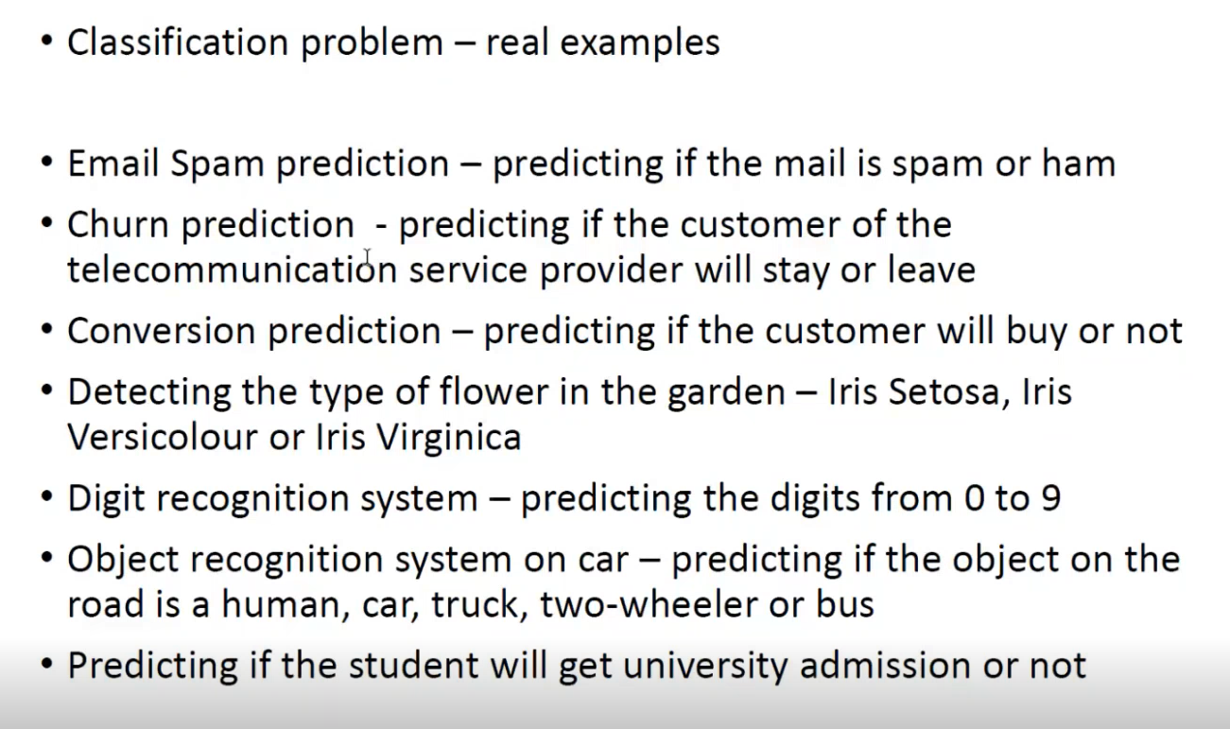

Slide 26
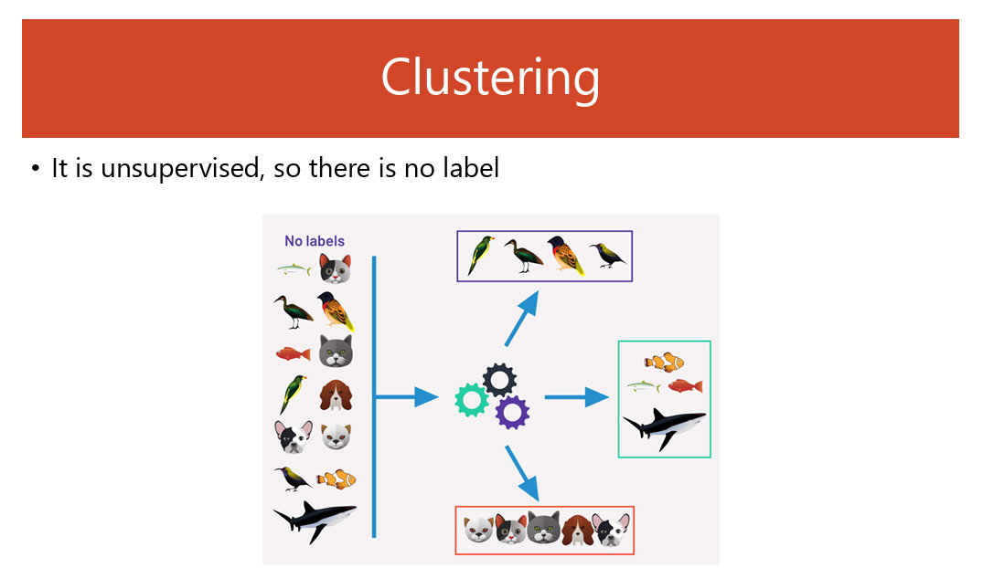

Slide 27
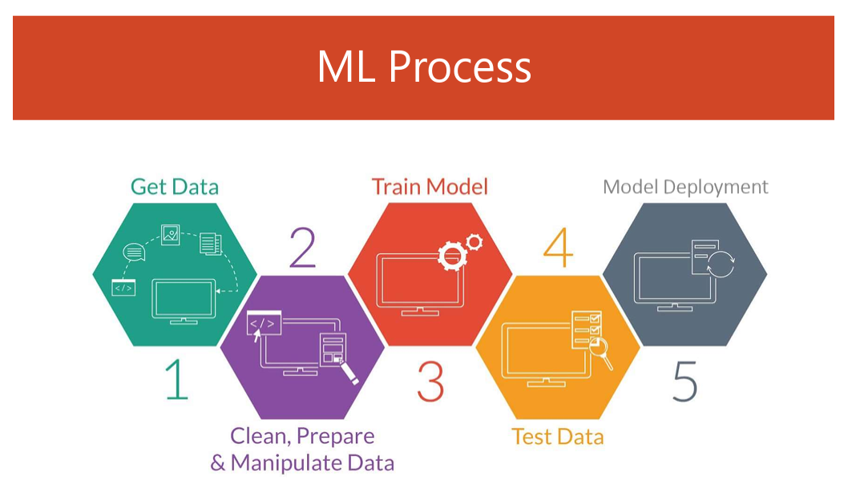

Slide 28
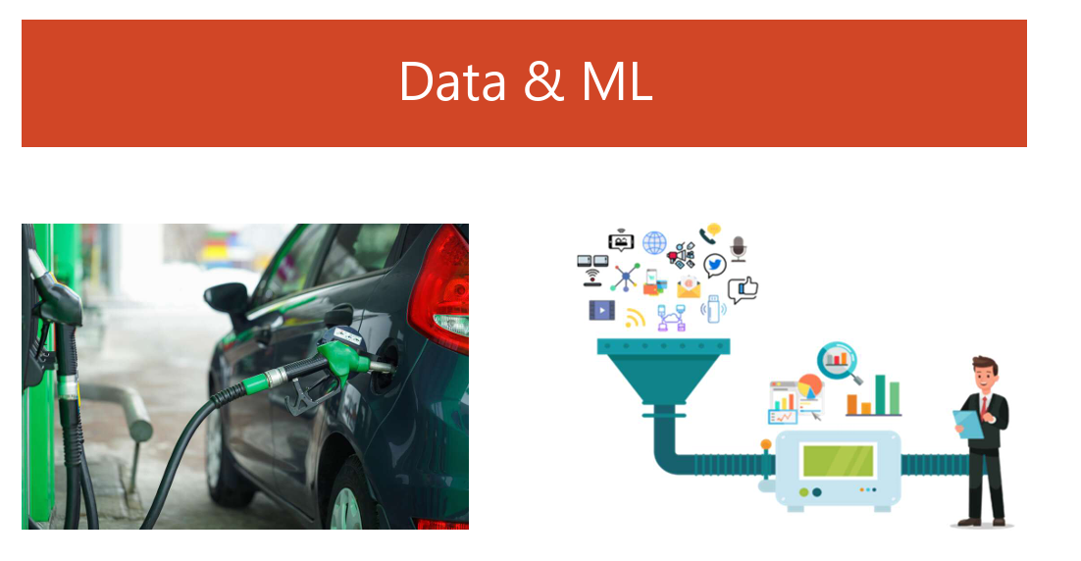

Slide 29
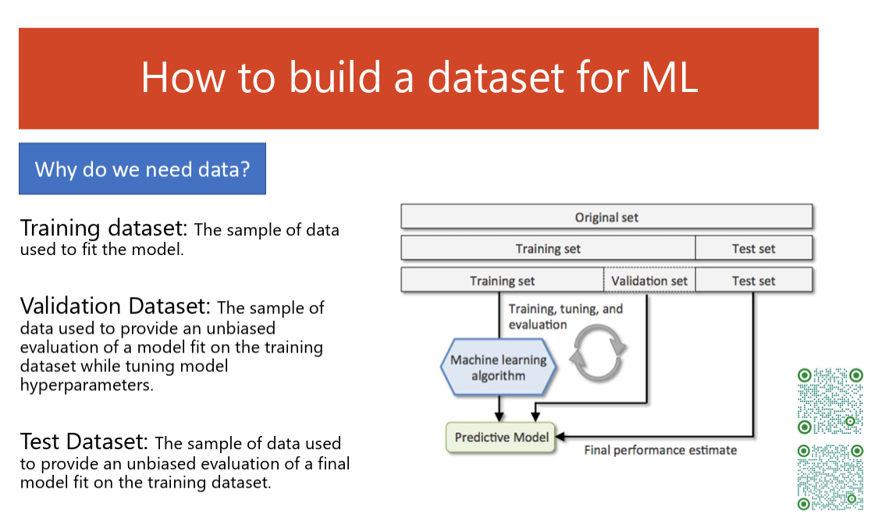

Slide 30
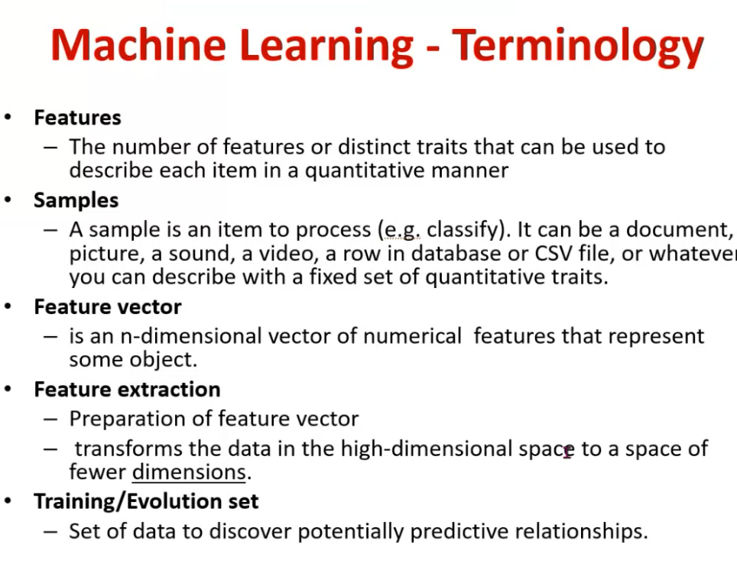

Slide 31
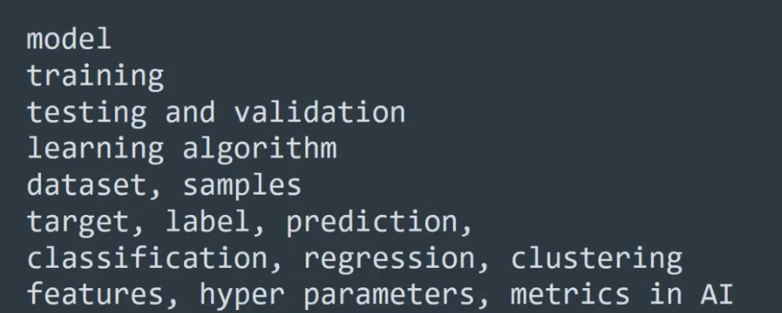

Slide 32
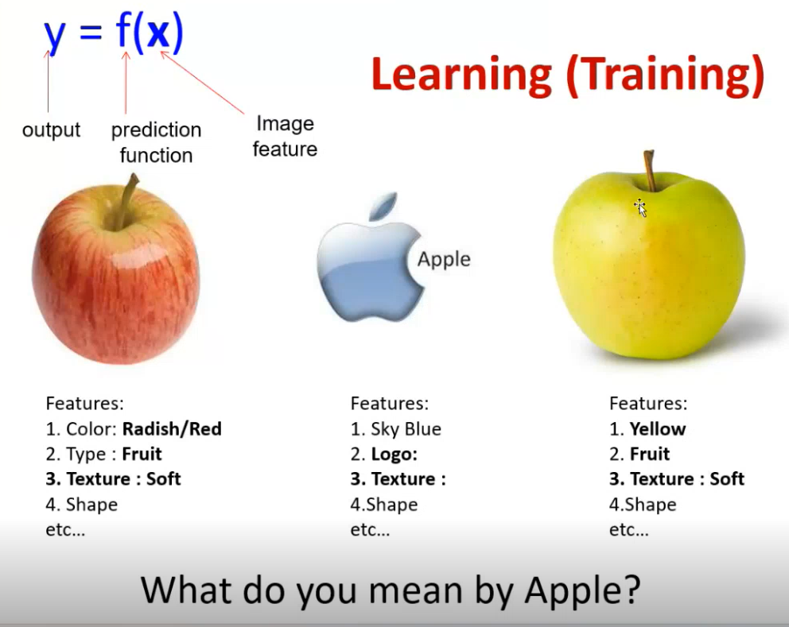

Slide 33
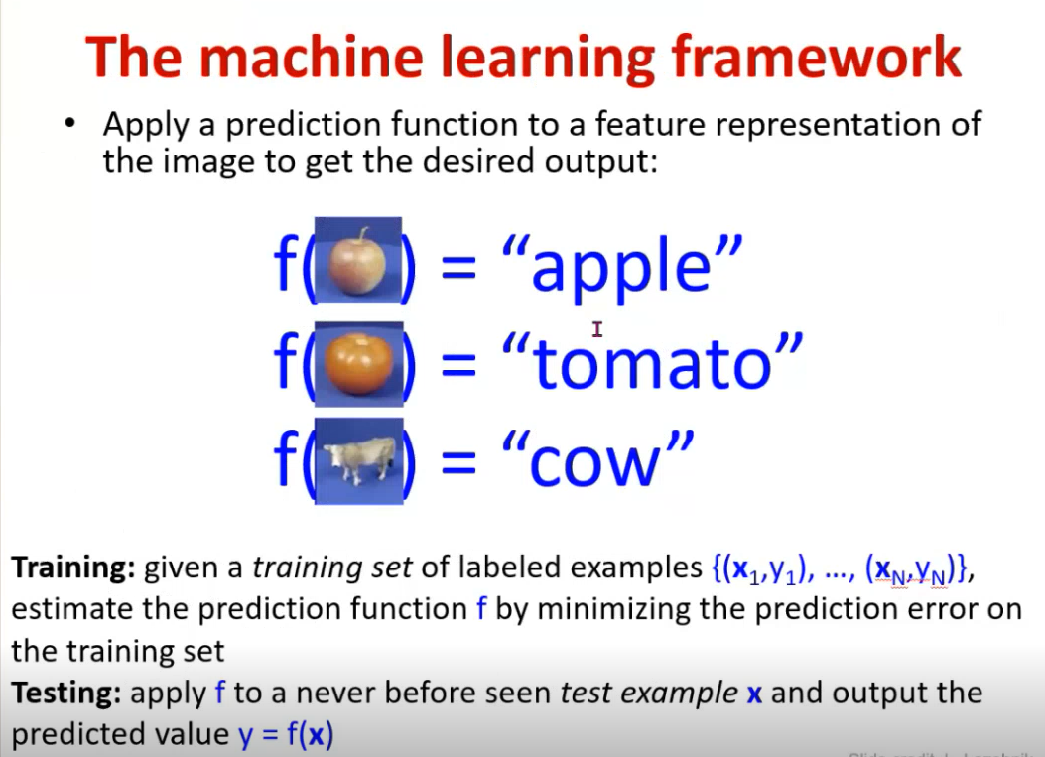

Slide 34
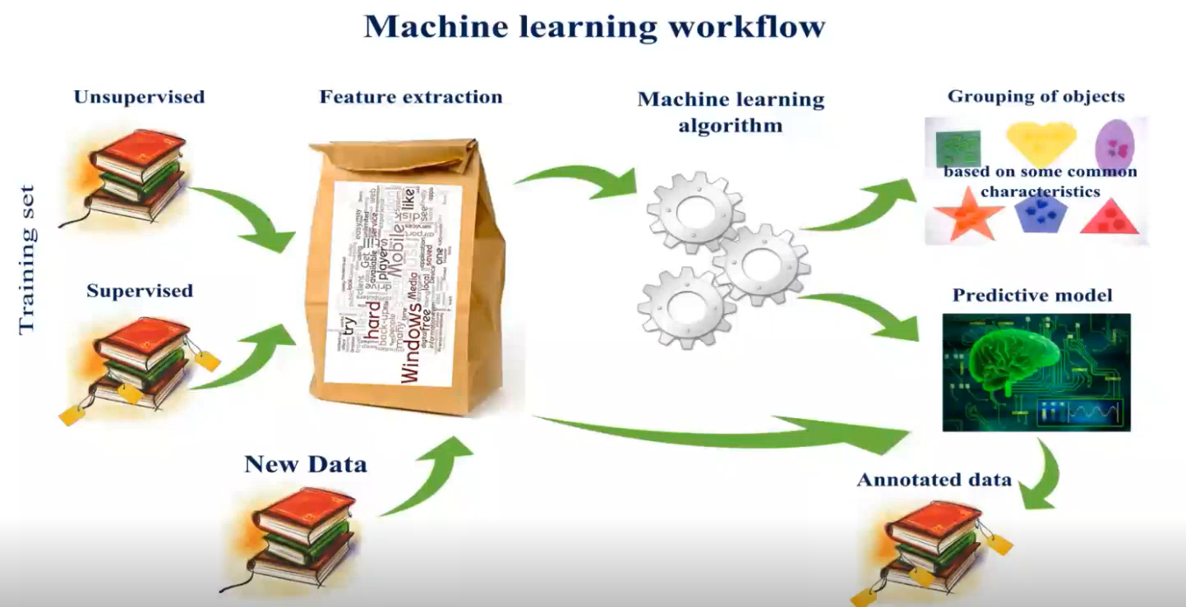

Slide 35
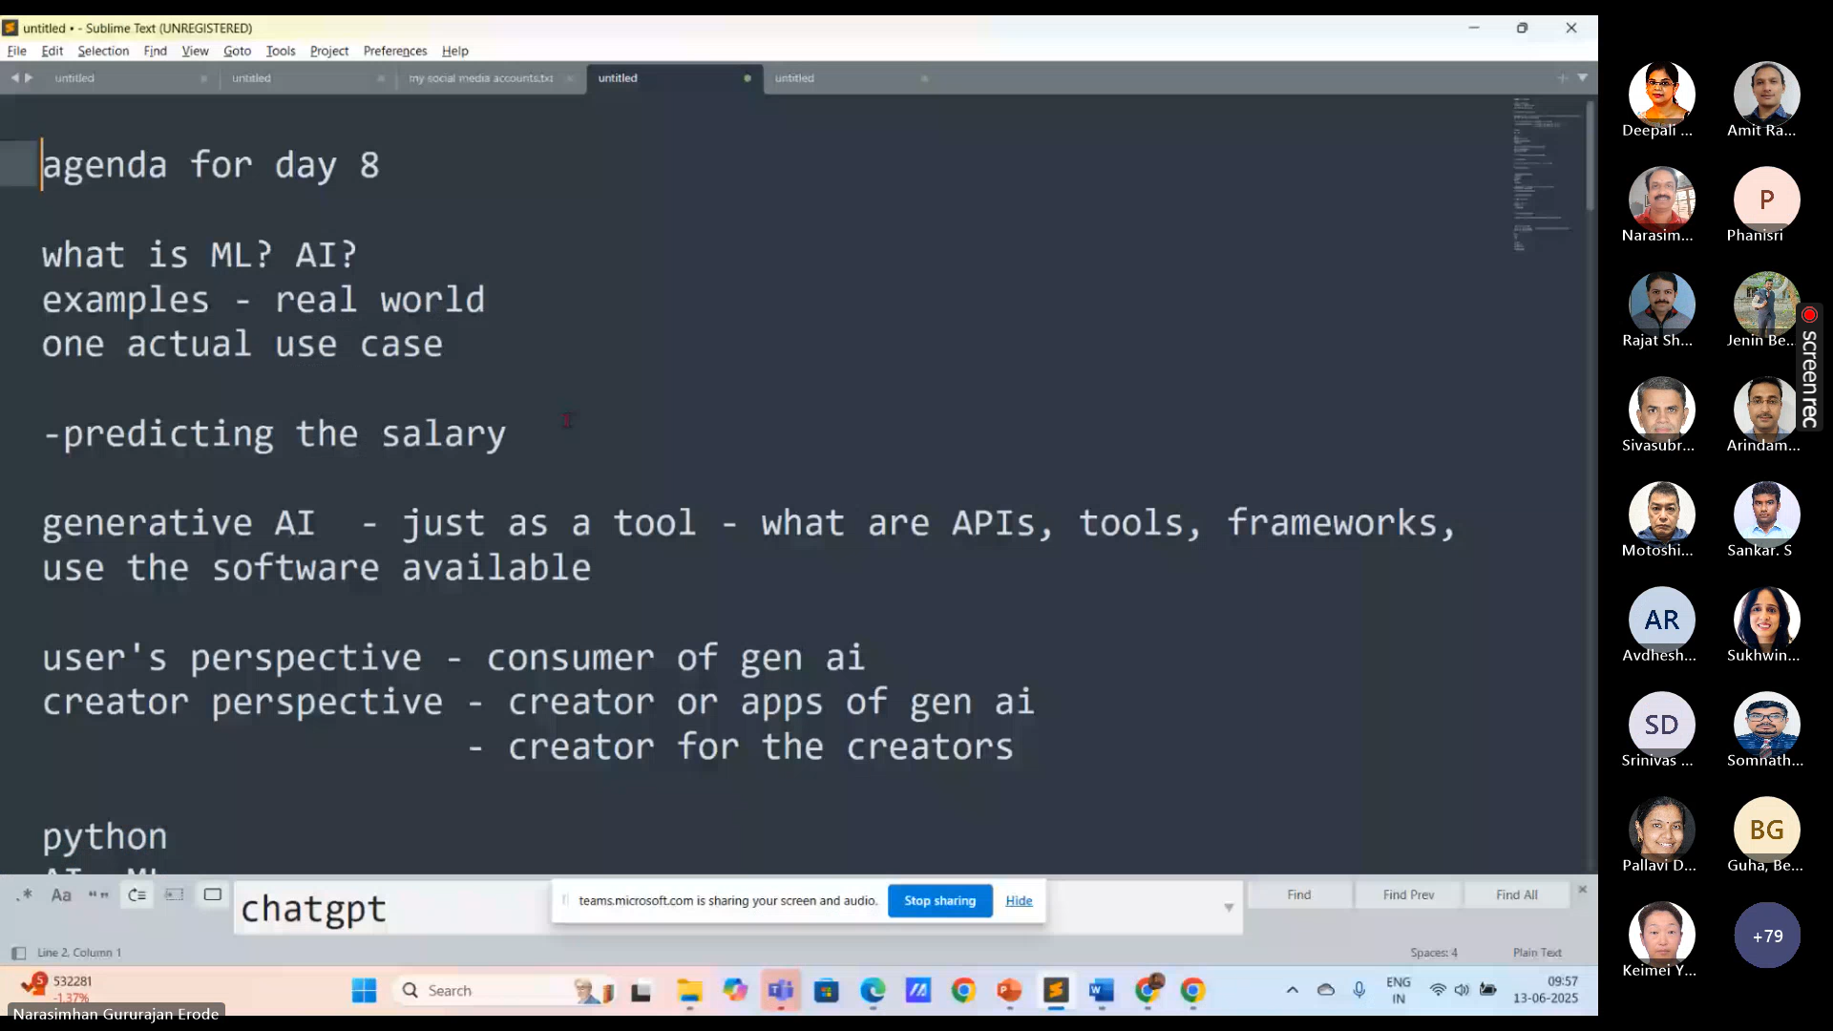

Slide 36
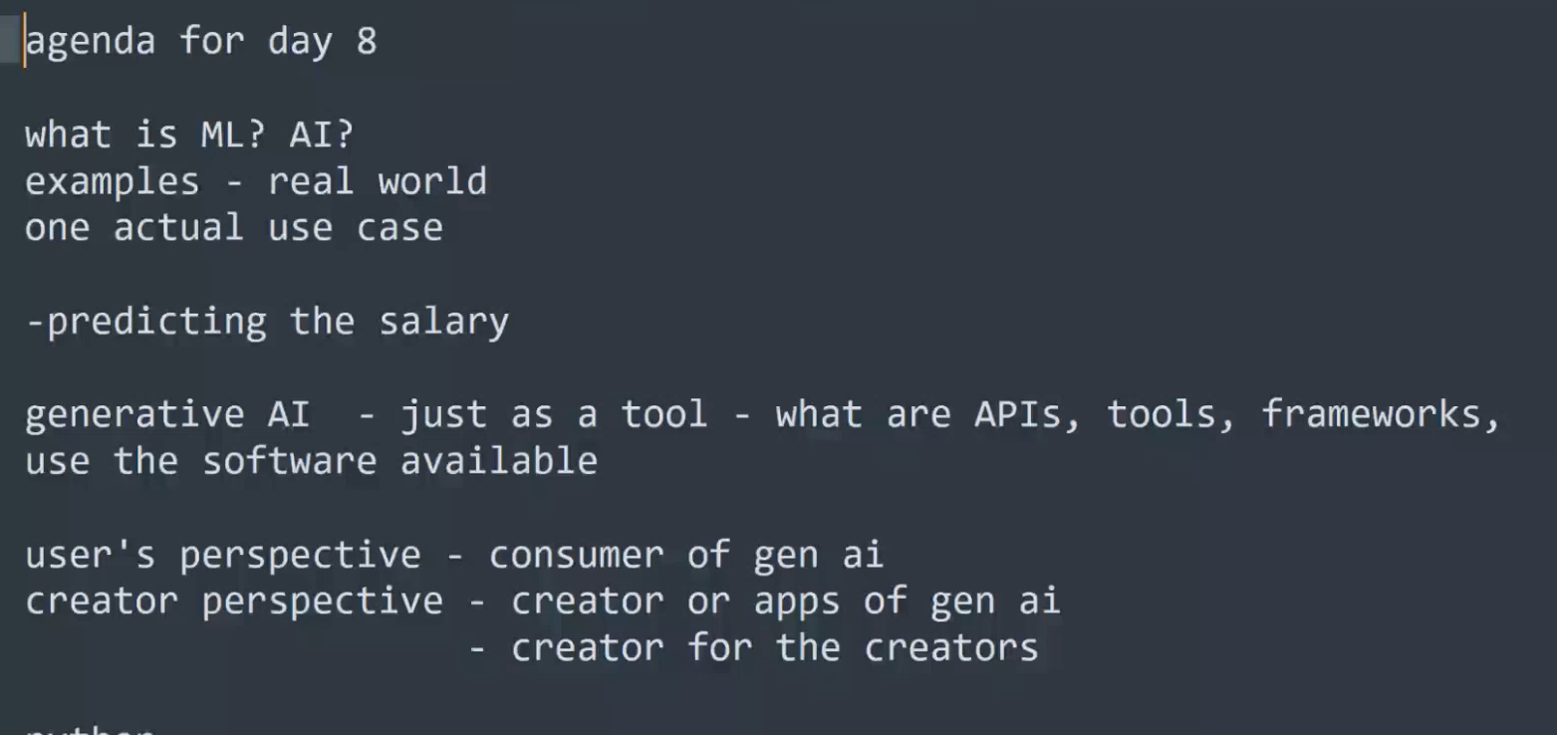

Slide 37
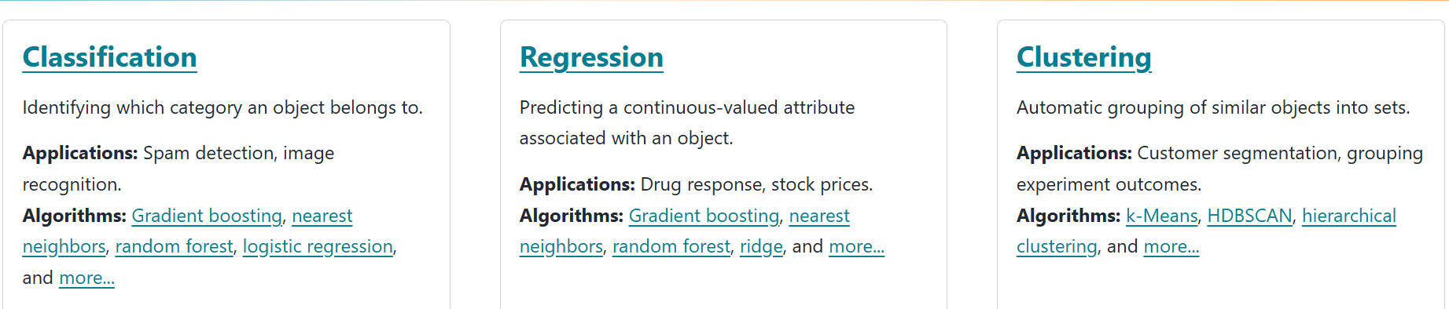
https://scikit-learn.org/stable/

